Slide 1
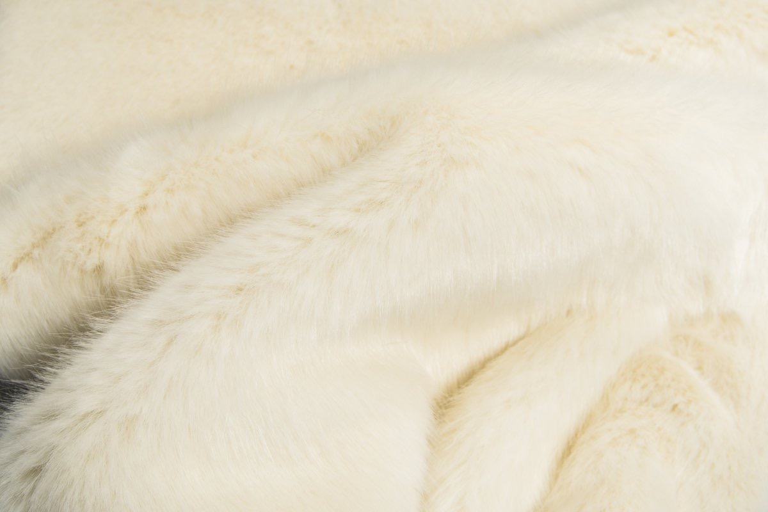
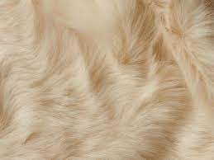
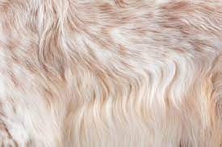
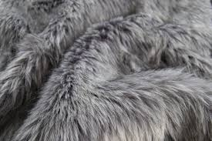
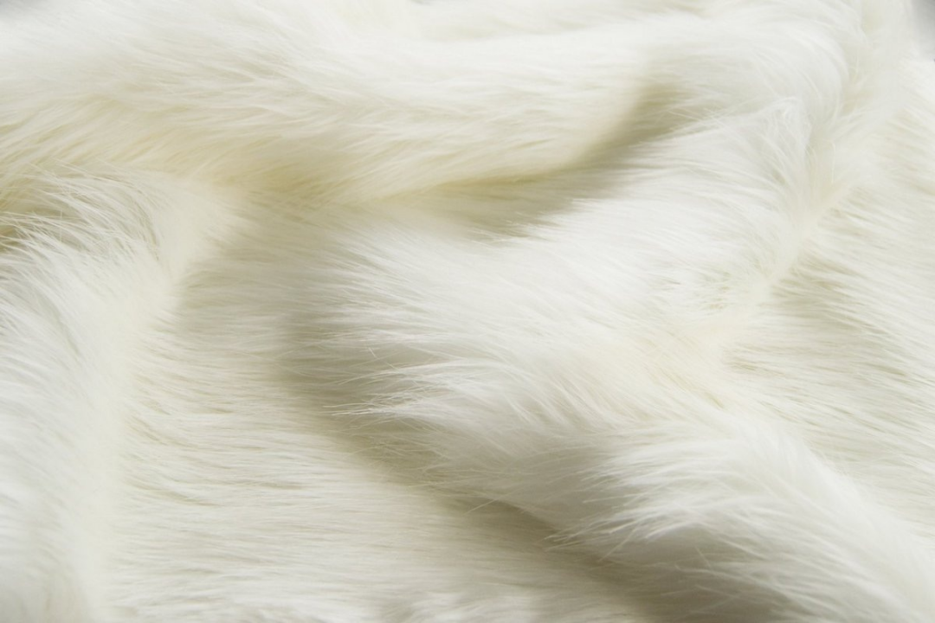
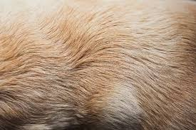
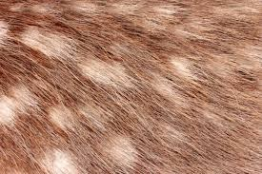
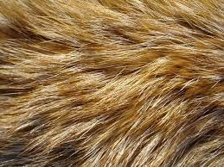
Bio-synthetic Fur
Presented by Gu Hongbin
anthonyguhongbin@outlook.com

Slide 2
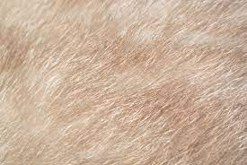
Executive Summary
Product & Methodology
Bio-synthetic Fur
Market
Operation Plan
Finance

Slide 3
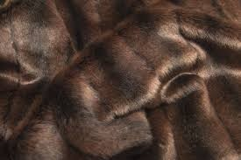
Executive Summary
The fur industry is in urgent need of change due to environmental and animal protection concerns.
We are using iPSCs & Immortalized Cell Line technology to create a revolutionary new product: Bio-synthetic Fur.
Bio-synthetic Fur is an alternative to both genuine and faux fur.
This new ecological and ethical product will address the main existing ‘pain points’ of the fur industry, and rekindle customer interest in this oldest garment material.
BIO-SYNTHETIC FUR

Slide 4
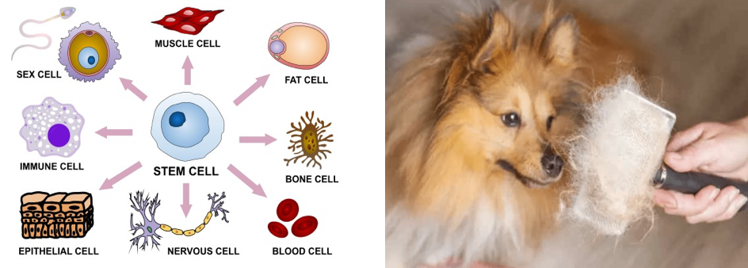
Product & Methodology
Semi Bio-synthetic
Semi bio-synthetic fur combines the iPSCs or Immortalized Cell Line technology and an unique process called Woolization*. This saves time for keratinocyte differentiation and simplifies the current supply chain.
*Woolization: a concept inspired by wool shearing, i.e. collecting hair from farming animals.

Slide 5
Market
According to Gitnux (2023), global fur sales reached $35.8 billion in 2018.
Global market for Artificial Fur estimated at US$ 176.8 million in the year 2022, is projected to reach a revised size of US$ 388 million by 2028.
As a disruptive alternative material, bio-synthetic fur is entering a multi-million growing market.
Faux Fur Market
Conservative Estimation:
Multi-million Growing Market

Slide 6
Market Position & Pricing (an example)
Laboratory Stage
Mass Production
Chosen one only
The most luxury and expensive
Exclusive Fabric
-
Dominant market share
Lower price than genuine fur
Popular Fabric for Winter
https://www.wjx.cn/report/230890397.aspx?sat=1

Slide 7
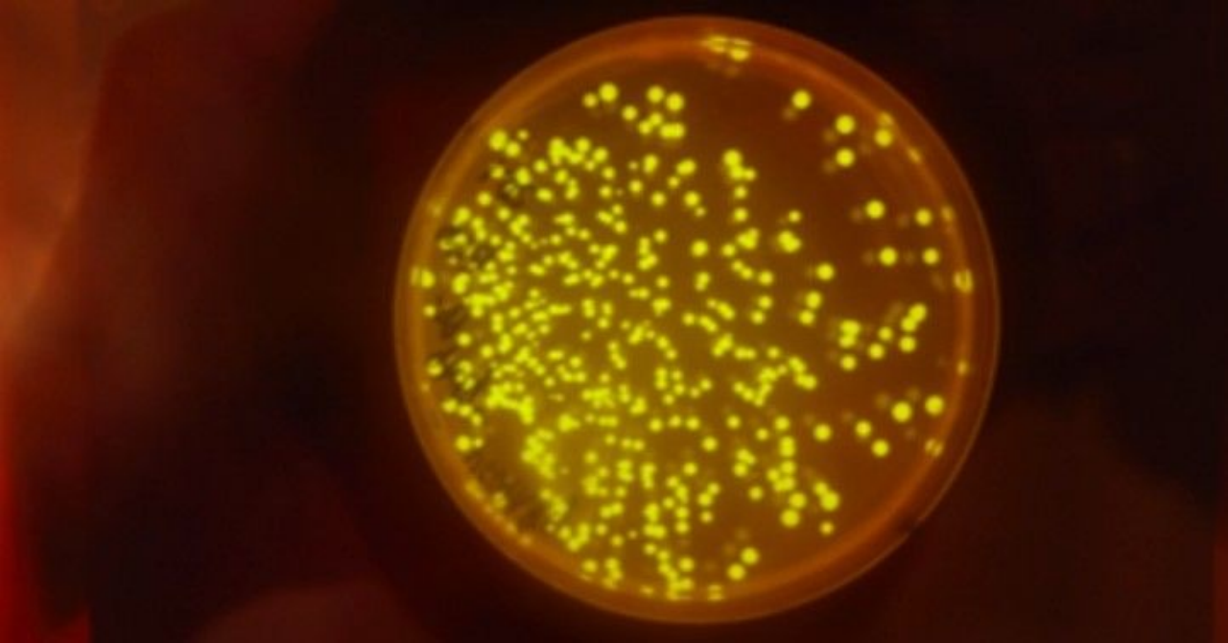
Market Competitor
Mansion/0
A program, collaboration between LVMH and Central Saint Martins, focusing on fur and other issues in “regenerative luxury” since 2017.
Competitor Analysis
Pros | Cons
Lab-grown fur experimentation: mink keratin in yeast, now moving into fibre development | No Aggregation: too many collaborators hoping for dominance, too broad research range
Powerful back team | Research-dominant rather than focus on commercialization
 | Challenges for original industry
CSM, UAL
LVMH
FENDI
TOM ELLIS LAB, IC

Slide 8
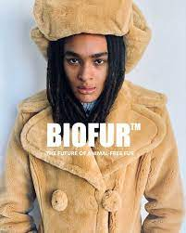
Market Competitor
Bio Fur
Animal-free fur — BIOFUR™. All pieces in this collection are made from plant-based or recycled textiles, and all pieces can be recycled or have been treated with an additive to help any synthetic fibers decompose naturally if they should end up in a landfill or the ocean.
Competitor Analysis
Pros | Cons
Plant-based methodology | The focus is still on common furs such as wool and camel's hair rather than the more expensive varieties.
Mature Output | Retail price is still high than genuine fur
 | Performance

Slide 9
Operation Plan-Business Model
R&D
University Collaboration-- Columbia University, USA
Commercial Lab-- ARM, China
Initial Manufacture
OFY Ltd, China
+ Patent/ Technology
- Cost
+ Product
- Patent/ Technology
Bio-synthetic Fur
+ Profit
- Products
+ Product/ Profit
- Part-patent/ Technology
B2B
Fashion Brands
Garment Companies
Authorized Manufacture
Bio-synthetic fur is manufacturing B2B based. Utilizing patents and technological strengths to increase profit channels and margins, finally reach B2C in the future with brand, Nidus Gu
B2C(After 2033)
NIDUS GU

Slide 10
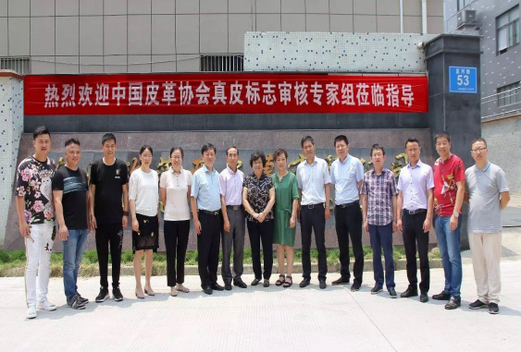
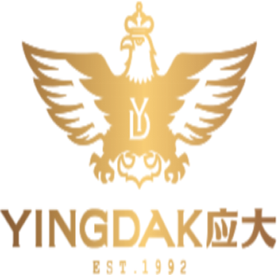
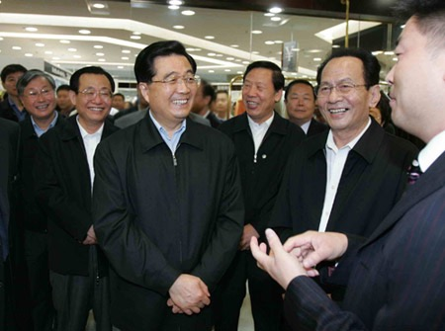
Operation Plan-Cooperation
R&D
Collaborating with Dr. Chandran’s KC LAB (Columbia University) & ARM
We have a verbal commitment, and have already started implementing the first steps of an estimated 2-year collaboration period.
Dr. Kartik Chandran is the professor of Earth and Environment Engineering in Columbia University.
Manufacture
OFY LTD as an authorized production base was originally one of the most consistent quality-controlled factories in the fur industry in China
We are also collaborating with Yingdak Group (cooperated enterprise with OFY), the most influential capital investment firm in the Beijing-Tianjin-Hebei region.

Slide 11
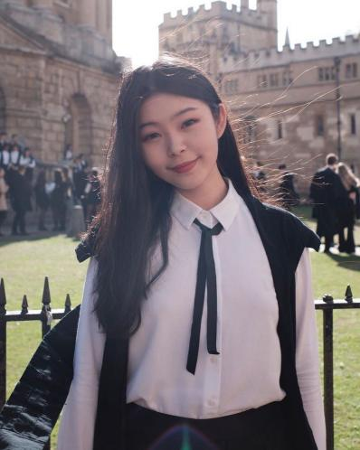
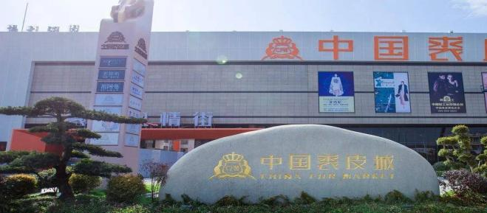
Operation Plan-Location & Personnel
KC LAB, Columbia University
R&D Center
Mature Technology
& Talent
Gu Hongbin
Chef Planner Concept Maker &
Program Founder
Master in CSM in progress
Zhou Kangzhe
General Technical Advisor & R&D Director
PhD in Columbia in progress
Li Chang
Project Financial Director & Strategy Advisor
Master in Oxford in progress
Ningbo, China
Mass Production Base
Complete Supply Chain
High Manufacturing Efficiency

Slide 12
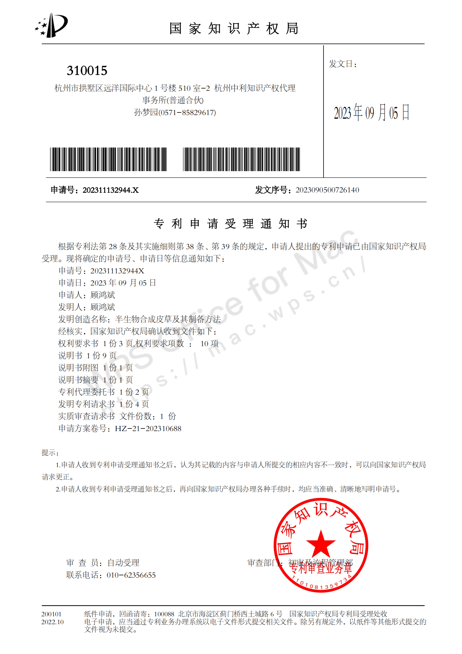
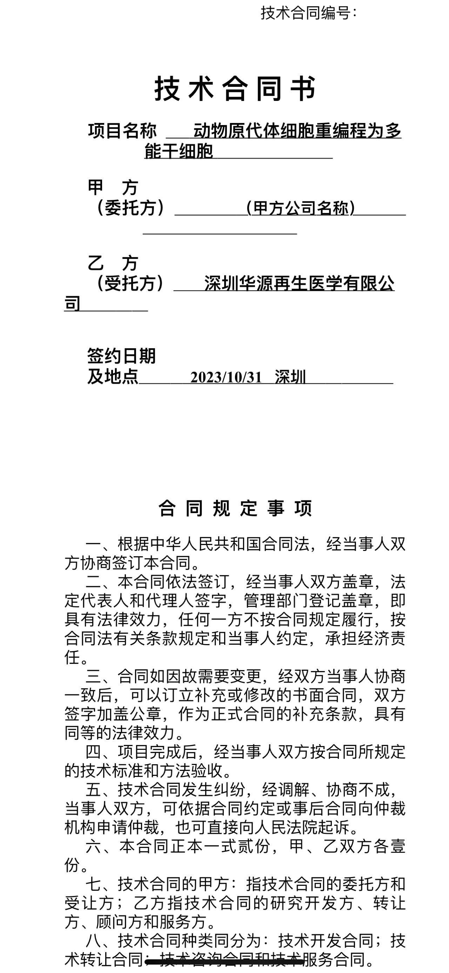
Operation Plan-Stonemile
Patent Approval (First Trial) in China Mainland
On track to complete the cell culture programme this year

Slide 13
Call for Collaboration
Investors
We seek $250,000 shortfall in funding for the R&D phase.
Opportunities for subsequent investment in mass production and future technical collaboration.
Return: 5% income right（mainly including patent revenue and product revenue) and a right of first refusal on subsequent investments.
Brands
We seek collaboration with luxury brands in the application of bio-synthetic fur, and channels for promotion and retail.
Return: Sharing patents rights and exclusive 5-10 year supply guarantee for mass production.

