Slide 1
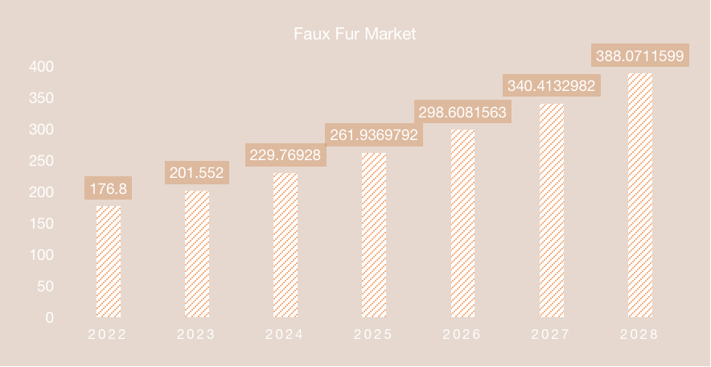
BIO-SYNTHETIC FUR
A unique painless process (Woolization) of obtaining hair directly from fur animals and then relying bio-technology and cytotechnology to synthesize skin panels, which in combination results in a new product that is identical to genuine fur without harming and cruelty for environment and animal.
This is the first attempt of iPSCs technology in the field of fashion industry.
It's been on patent application in China Mainland.
Authority Collaboration
Material Innovation
Industry Revolution

