Slide 1
Bio-synthetic Fur
Market Intervention

Slide 2
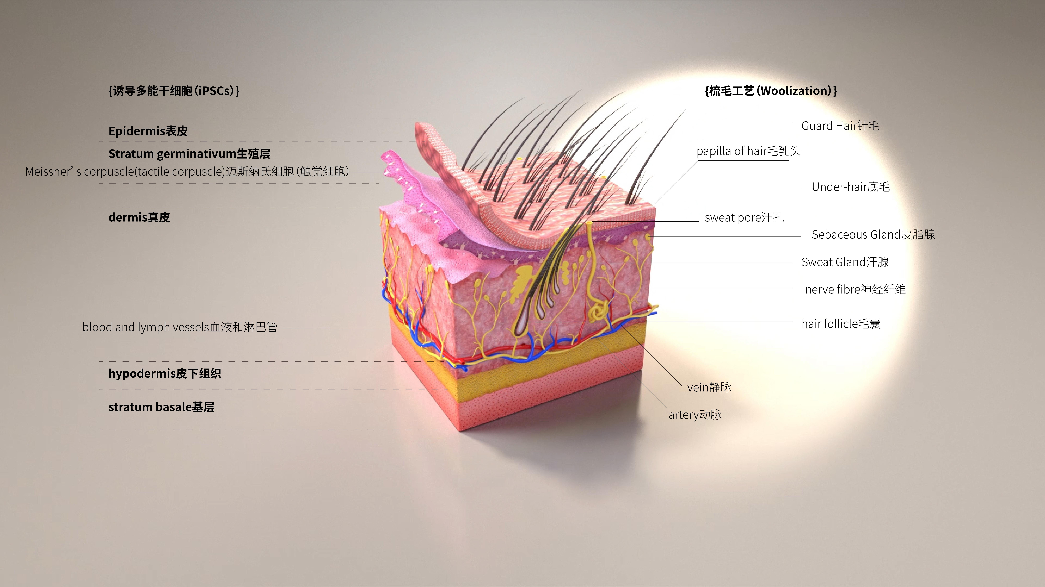
Illustration
This is a mink fur, however, it is not obtained from mink, instead it is a laboratory synthesis.

Slide 3
产品概览
这是一张特殊的水貂皮，它不是从动物身上获取而是通过实验室生物合成的

Slide 4
Participant 1
What is your occupation/background?
Will you accept fur in this form?
A. YES
B. NO(Reason):
How much extra are you willing to pay for this kind of product? (Genuine mink garments are known to sell for $1000 average)
A. No premiums accepted for fake fur
B. Equivalent price accepted（+-10%）
C. Slight premium accepted(+15%)
D. Any price accepted

Slide 5
参访者1
您的职业/背景
您会接受这种形式的皮草吗？
A. 会
B. 不会（原因）:
您会愿意为这种全新的皮草承担多少溢价？（已知真皮成衣的销售均价在1000美金）
A. 不愿意为假毛承担任何溢价
B. 愿意承担与真皮相符的售价
C. 愿意承担轻微的溢价
D. 愿意承担任何的溢价

