Slide 1
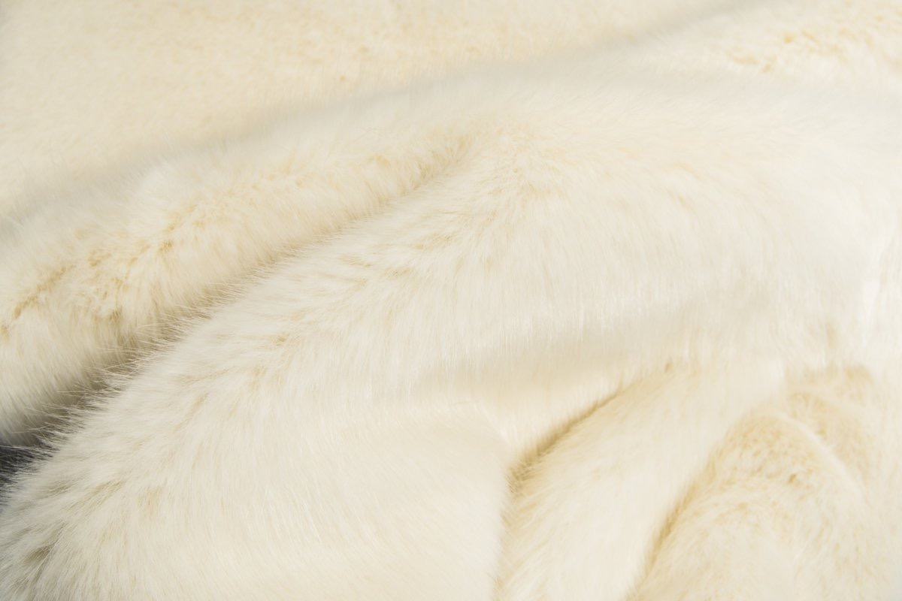
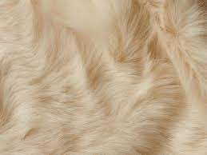
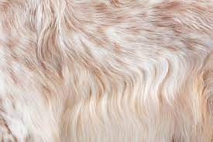
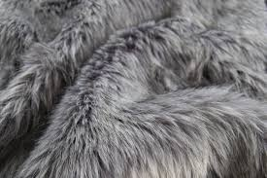
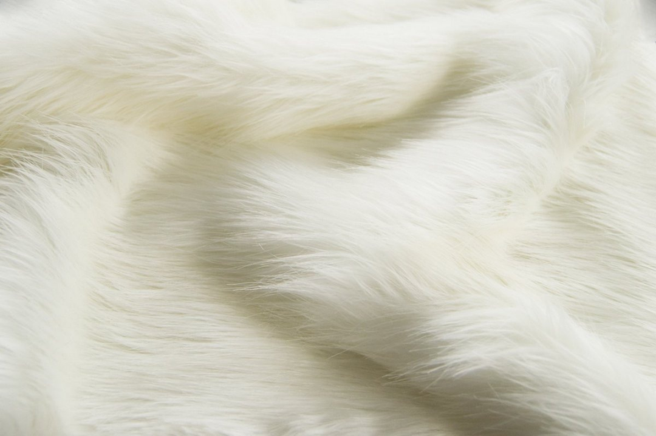
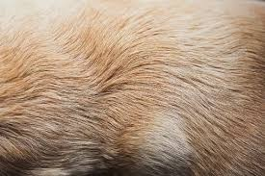
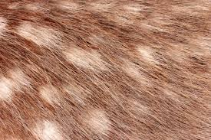
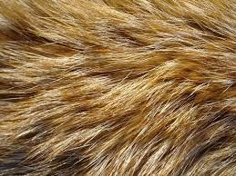
Bio-synthetic Fur
Gu, Hongbin
anthonyguhongbin@outlook.com

Slide 2
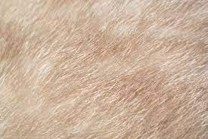
Executive Summary--WWHI
Product & Methodology
Bio-synthetic Fur
Market
Operation Plan
Finance

Slide 3
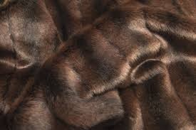
WWHI
What: Bio-synthetic fur is an alternative for both genuine and faux fur.
Why: Current industry urgently asking for transformation due to the concern of environment and animal protection.
How: Experimenting biotechnology(iPSCs Transplanting) to create new products meeting new consumer needs.
What if: Addressing the main existing pain points of the fur industry and rekindle customer interest in this oldest garment materials.
BIO-SYNTHETIC FUR

Slide 4
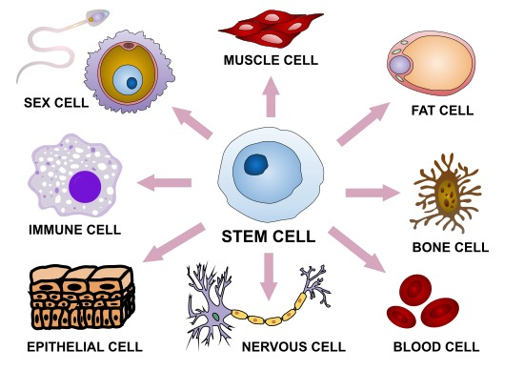
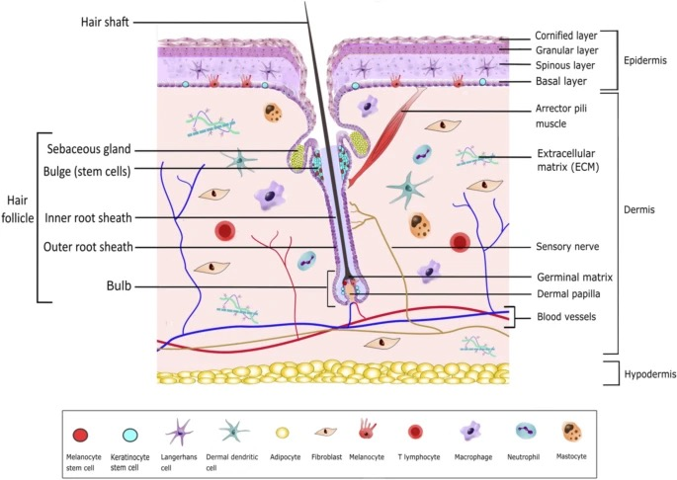
Product & Methodology
Fully Bio-synthetic
iPSCs: Multipotent blood and skin cells that have been regressed to a pluripotent state enabling them to differentiate into a greater range of cells.
Using iPSCs culture all needed cellular structures of fur and then combined.

Slide 5
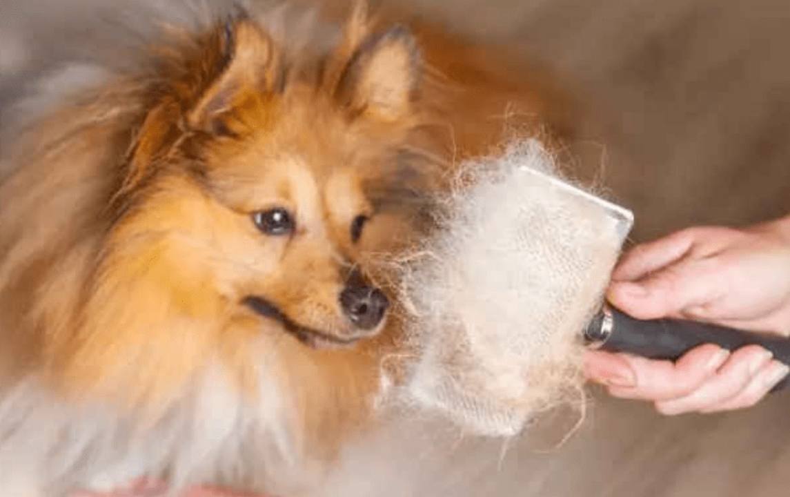
Product & Methodology
Semi Bio-synthetic
Woolization: It is a concept inspired by wool shearing that collecting hair from those farming animals like mink and fox.
Semi bio-synthetic fur combines the technology of stem cell transplantation for only the hypodermis and the dermisand and then unique process called woolization to form epidermis, saving time for keratinocyte differentiation and saving part of original supply chain.

Slide 6
Market
According to Gitnux(2023), global fur sales reached $35.8 billion in 2018.
Global market for Artificial Fur estimated at US$ 176.8 million in the year 2022, is projected to reach a revised size of US$ 388 million by 2028.
As a disruptive alternative material, bio-synthetic is coloured by a multi-million growing market.
Faux Fur Market
Conservative Estimation: Multi-million Growing Market

Slide 7
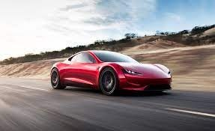
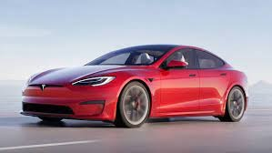
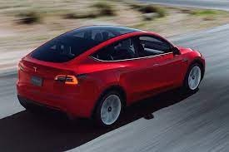
Market--Position $ Pricing
Laboratory Stage
Mass Production
Intensive Mass Production
Tesla Roadster
Tesla Model S
Tesla Model Y
Exclusive fabrics for the powerful
The most luxury and expensive fabric material
High-end & technical fabric for wealthy people
Price reference to Vicuna and Mulberry Silk
Absolute leader of fur market share
Price aiming to gain more market share

Slide 8
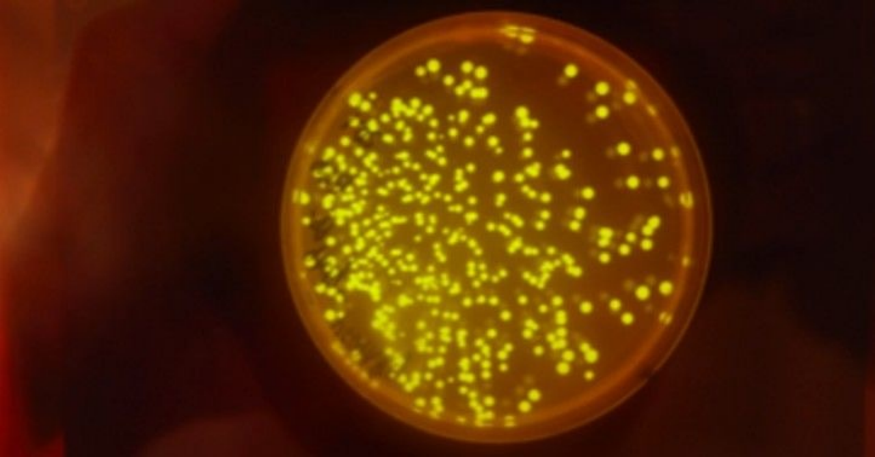
Market--Competitor
Mansion/0
A program cooperated by LVMH and Central Saint Martins are targeting on fur and other issues in “regenerative luxury” since 2017.
Competitor Analysis
Pros | Cons
Lab-grown fur start early: proceed mink keratin in yeast and is now moving into fibre development | No Aggregation-- too much collaborators hoping for dominance and broad research range even for mammoth
Powerful back team | Research-dominant rather than focus on commercialization
 | Challenges for original industry
CSM, UAL
LVMH
FENDI
TOM ELLIS LAB, IC

Slide 9
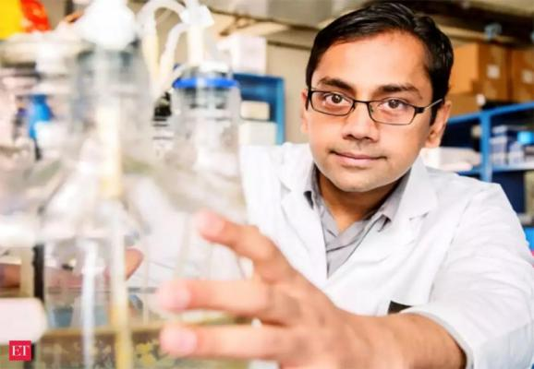
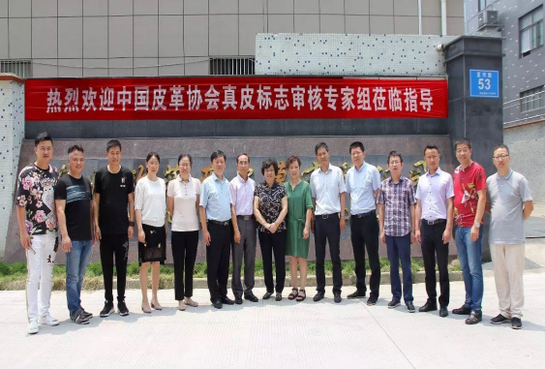
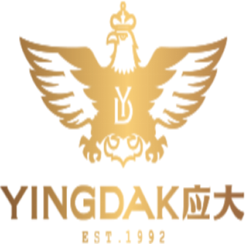
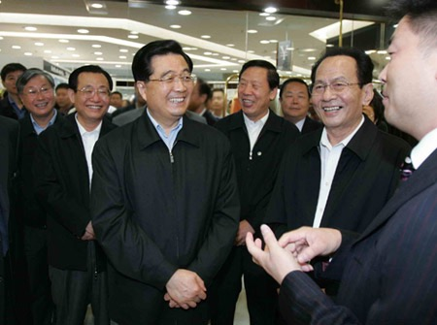
Operation Plan--Cooperation
R&D
Cooperated with KC LAB, which has received a verbal commitment to participate by Dr. Chandran and has already started implementation for 2-year period estimated.
Kartik Chandran is the professor of earth and environment engineering in Columbia University.
Manufacture
OFY LTD as an authorized production base was originally one of the most consistent quality-controlled factories in fur industry over China
Also cooperating with Yingdak Group(sibling enterprise with OFY) , the most influential capital in the Beijing-Tianjin-Hebei region.

Slide 10
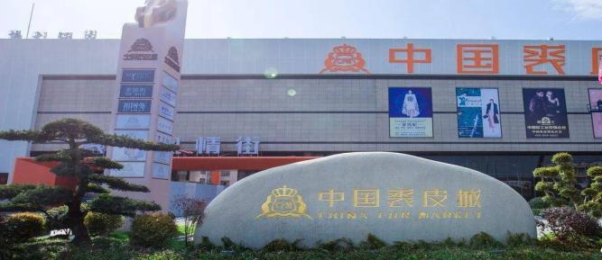
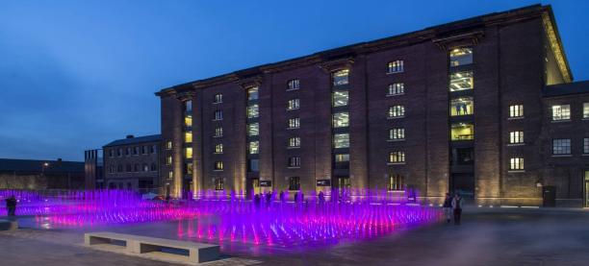
Operation Plan--Location & Personel
Columbia University
New York
R&D Center
Mature Technology
Sufficient Talents
Ningbo
China
Mass Production Base
Gu, Hongbin
Concept Maker
&
Program Founder
Master in CSM in progress
Zhou, Kangzhe
General Technical Advisor & R&D Director
PhD in Columbia in progress
Li, Chang
Project Financial Director & Strategy Advisor
Master in Oxford in progress
Complete Supply Chain
High Manufacturing Efficiency
Central Saint Martins
London
Communication Center
Radiation to Whole European Market

Slide 11
Finance
Start-up Cost List
Cost Description | Cost($) | Rationale | Tips
Project Researcher Salary | $70,000 per year Projected cycle of 2-3 years with total $210,000 | Approval from KC LAB, funding for exclusive PhD researchers of bio-synthetic fur | Consultation with laboratories on milestone-oriented payments
Laboratory Funding | $100,000 for two years | Business partnership start-up funding of KC LAB | Part-covered by project owner
Communication Cost | $25,000 annually | Cost of phase communication, verification and advertising | Already fully covered by project owner
Total | $350,000 estimated

Slide 12
Call for Cooperation & Commitment
For Investor
Seeking: $250,000 shortfall in funding for R&D phase, meanwhile, it asks for subsequent investment in mass production and other technical collaborations.
Return: 5% income right（mainly including patent revenue and product revenue） and a right of first refusal on subsequent investments.
For Brand
Seeking: Channel, promotion and cooperation in the application of bio-synthetic fur (Luxury and Material Giant Favour).
Return: Sharing the right to use patents and the exclusive 5-to-10-year supply guarantee for mass production in the future.

